Slide 1

Movies Galore
BY GROUP 1

Slide 2

What is Movies Galore?
This is a web-based database that is intended to be able to:
Store movies
Filter movies
Rate movies
Play movies

Slide 3

Who can use Movies Galore?
Movies Galore is for everyone! All that is required by Movies Galore is a user account.
A user account requires the following:
Username
Password
Email
First name, last name

Slide 4





How does it work?
Once a user account is created a user is able to do some of the following:
Add movies to their own personal database
Add actors and directors to that movie
Add details about the movie such as character roles and genres

Slide 5

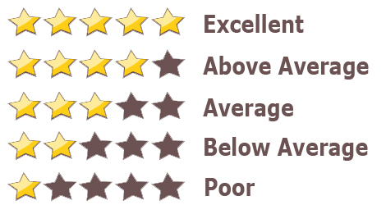

Socializing
Extra features that come with the created account are:
Create their own movie playlist
Rate their movies
Subscribe to other user accounts
Subscribe to other user playlists
Rate other users movies

Slide 6
Functional Specifications
Must allow users to login.
Must allow users to store their movies.
Must allow users to rate their own movies.
Should allow users to create their own playlists.
Should allow users to subscribe to other users.
Should allow users to rate other users profiles.
Must allow users to edit their movies
Must allow users to delete their movies
Must allow users to view other users
Must allow users to play the movies
Must allow non-users to view other users
Must allow non-users to register

Slide 7
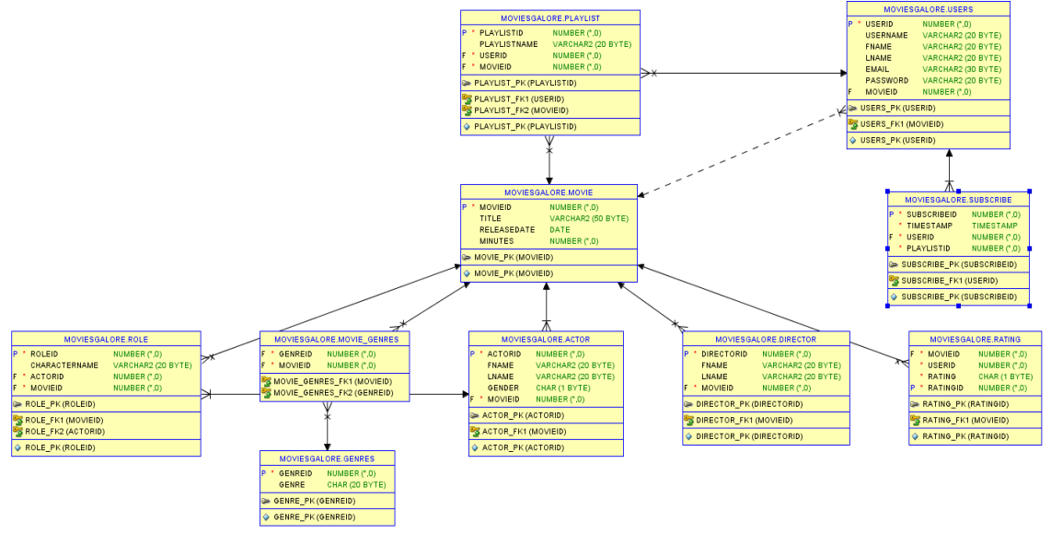
UML DIAGRAM

Slide 8
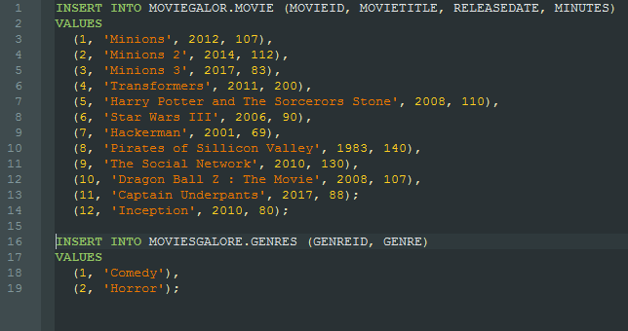
Sample Data

Slide 9
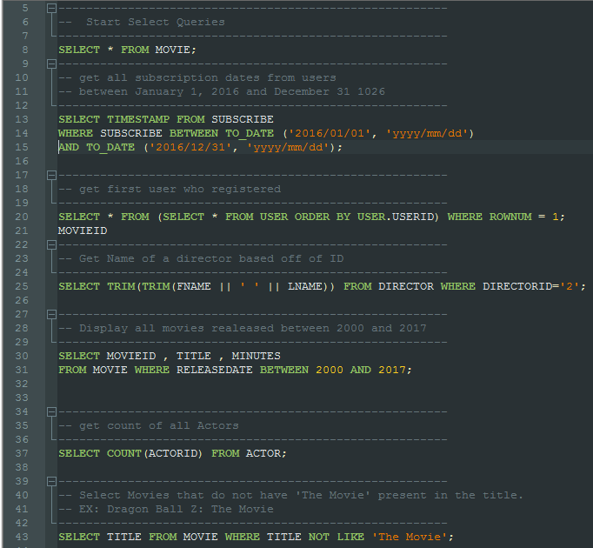
Queries

